Slide 1
GIFTED WITH DISABILITIES: TEACHING MUSIC TO SPECIAL LEARNERS
SPECIAL LEARNERS/CURRICULUM
NYSSMA Winter Conference, Rochester, NY
Thursday, December 3, 2009 7:15 p.m.
CC Cascade ABC. Elise Sobol, Clinician

Slide 2
Some of Society’s Most Gifted
Workshop Description
Drawing inspiration from society’s most gifted performers, presenter will share curriculum topics from her newly revised text, “An Attitude and Approach for Teaching Music to Special Learners, Second Edition” (Rowman & Littlefield Education, 2008). With direct applications to inclusion programs (all grades) discussion will cover how to teach with consistent relevance and universal design.

Slide 3
Lest We Forget We Have a Social Obligation
Stephen Foster (1826-1864)
Wolfgang A. Mozart (1756-1791)
America’s pioneer songwriter (Beautiful Dreamer)
By today’s standards Stephen Collins Foster with his output of songs would be worth millions of dollars.
He died in New York on January 13, 1864 at age of 37 with 38 cents in his pocket and penciled scrap of paper that “dear friends and gentle hearts” a socially-emotionally-physically devastated man.
Let us flashback to 1791 –
Wolfgang Amadeus Mozart died in Vienna, a pauper at age 35 and is buried in an unmarked grave.
As educators, let us better take care of our most gifted members of society and help them to cope with pressures of daily living. Their contributions have served to effect societal change and our lives are enhanced daily by their musical gifts, past and present.

Slide 4
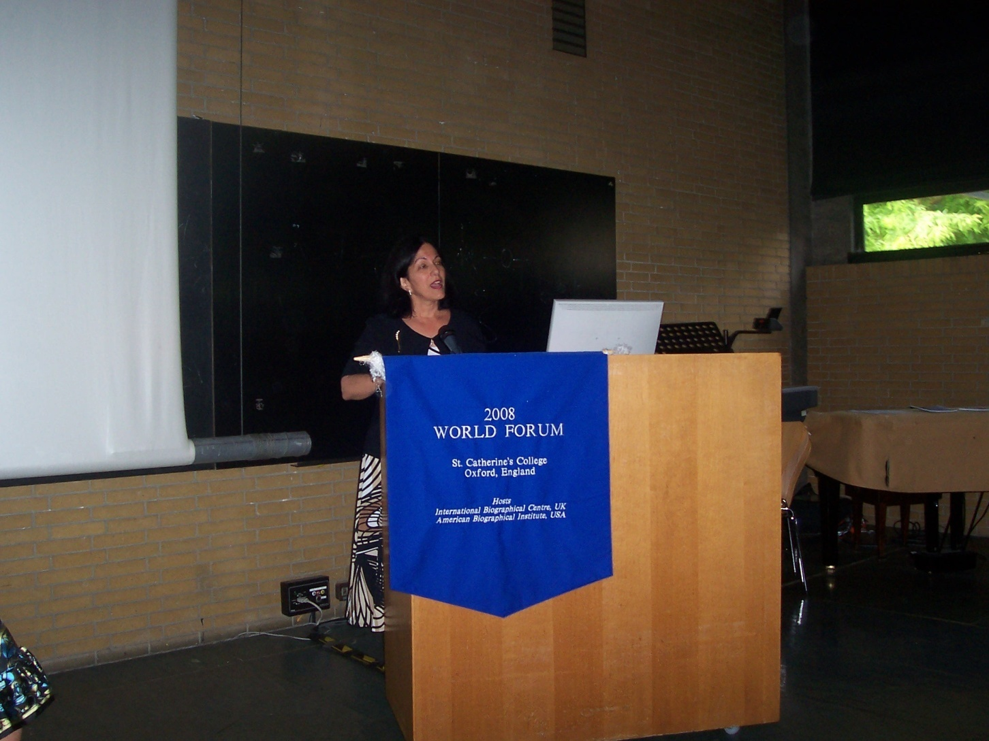
2008 World Forum, Oxford, England

Slide 5
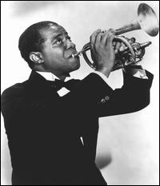
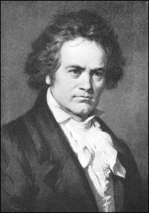
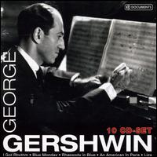
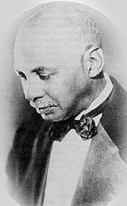
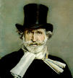
An Attitude and Approach for Teaching Music to Special Learners, 2001, 2008.
(1901-1971) (1770-1827) (1898-1937) (1873-1958)
L.V. Beethoven
Louis Armstrong
W.C. Handy
(1813-1901)
Giuseppe Verdi

Slide 6
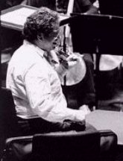
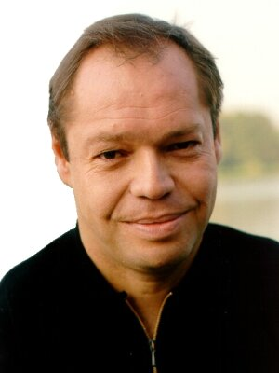
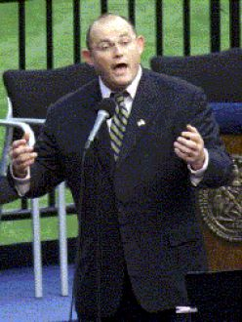
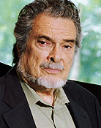
Gifted Students with Physical Disabilities
Current role models in music include (from left to right) Itzhak Perlman (b.1945), Violinist; Thomas Quastoff( b.1959), bass-baritone; Ronan Tynan (b.1960), tenor; Leon Fleisher (b.1928), pianist.

Slide 7

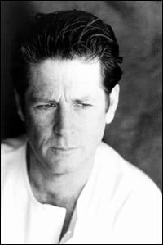
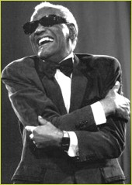
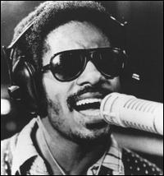
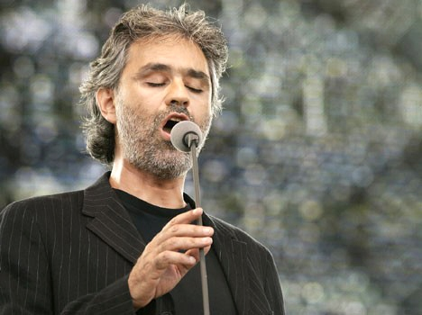
Gifted Students with Sensory Disabilities (continued)
Photographs of current role models in music with sensory disabilities: Dame Evelyn Glennie (b.1965); Stevie Wonder (b.1950), Ray Charles (1930-2004), Andrea Bocelli (b. 1958), Brian Wilson(b.1942).

Slide 8
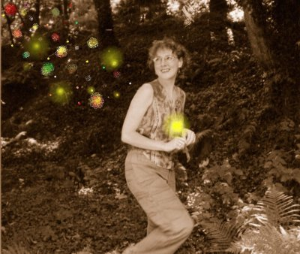
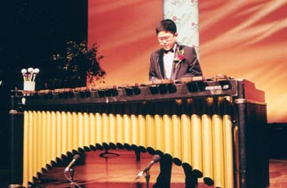
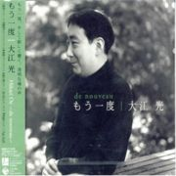
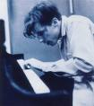
Gifted Students on the Autism Spectrum
Current role models include composers
Donna Williams (b.1963), Hikari Oe (b.1963) and performers Thristan “Tum-Tum”(b.1989) Mendoza and the late Glenn Gould(1932-1982) whose unconventional and eccentric personality shares many similarities with those who are on the autism spectrum.

Slide 9
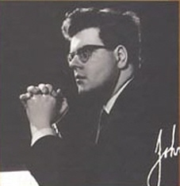
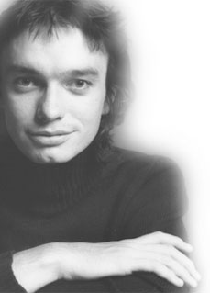

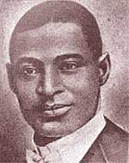
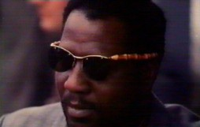
Gifted Students with Emotional Behavioral Disorders
Current role models in music include John Ogdon(1937-1989), award winning pianist, who was the subject of the BBC 1981 movie virtuoso based on his biography and his losing fight with mental illness and manic depression; the late Charles “Buddy” Bolden(1877-1931), Thelonious Monk(1917-1982), and Jaco Pastorius (1951-1987). Psychosomatic illness falls into this
category and one might be interested to study the life of the late great pianist and pedagogue, Vladimir Horowitz (1903-1989).

Slide 10
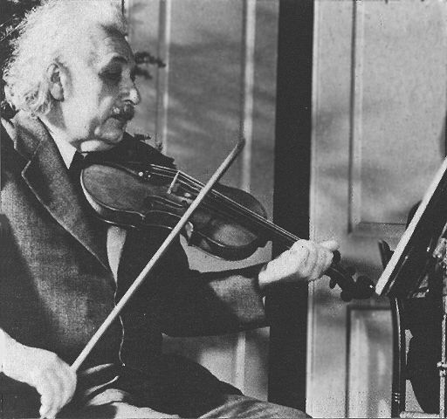
Gifted Students with Learning Disabilities and Attention Deficits
The largest subgroup of twice-exceptional students is those who are gifted and also have a specific learning disability that impact learning such as dyslexia, receptive, and expressive language. The greatest concrete example of giftedness is the life of Albert Einstein(1879-1955) who struggled to read in childhood. He didn’t speak until he was three, he was a passionate musician, an accomplished violinist, brilliant mathematician an scientist who of changed the world through the theory of relativity. Einstein once said that “I know that the most joy in my life has come to me from my violin.” “(From an article by Brian Foster, a particle physicist at Oxford University published in Physics World, January 2005)

Slide 11
Leave the World a Little Bit Better Charlotte Diamond (2003)
The aforementioned role models in music have made their personal lives public so that future generations may learn from their pain and struggles. With greater understanding there should develop less tragic life endings like Stephen Fosters, or Wolfgang Amadeus Mozart.“No society can afford to ignore its most gifted members, and all must give serious thought to how best to nurture and educate talent. (Ellen Winner, Gifted Children. 1996). How do we do this? The wonderful song ”Leave the World a Little Bit Better” has a few answers.

Slide 12
Etiquette for our Education Teaching our Children of All Abilities How to Live.
Leave the world just a little bit better,
A little better than it was,
Leave the world just a little bit better,
little better than you found it
When the sun came up.”
I’m only one and we are two
But there are others like me and you,
Step by step and hand in hand,
We can help our land.
I. I’m only one and we are two,
But there are others like me and you,
Step by step and hand in hand,
We can help our land. (Chorus)
2. If I listen to you and you listen, too,
Soon there’ll be others like me and you,
We know a word, it’s called “Respect”
Give what you expect.

Slide 13
Etiquette for our EducationTeaching our Children of All Abilities How to Live (slide 2 of song)
Leave the world just a little bit kinder,
A little kinder than it was,
Leave the world just a little bit kinder,
A little kinder than you found it.
When the sun came up.
3. If I smile at you and you smile too,
Soon there’ll be others like me and you,
Let’s send a giggle around the world
To every boy and girl.
Chorus La, la, la, Repeat verse one and Chorus.)
(“Leave the World a Little Bit Better”, by Charlotte Diamond, Reprinted with Permission, Hug Bug Music Inc. www.charlottediamond.com)

Slide 14
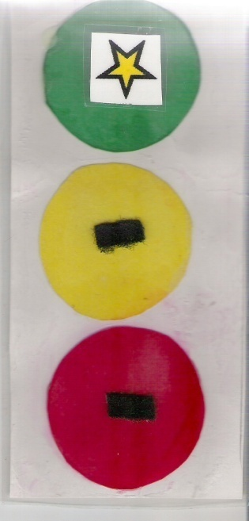
Specific Contributions to the Field
Upside Down Stoplight© for basics in music literacy in line with traffic lights, signs and symbols.
Sound Signals for Classroom Management©

Slide 15
Sobol Approach to Music Education that includes Seven Foundations:
1. Teacher’s love of children
2. Understanding those with special needs
3. Training 4. Skill
5. Reality based multi-sensory presentation
6. Active Patience
7. Belief in Positive and Possible

Slide 16
Music Basic to All Humankind
The musical/rhythmic intelligence is organically basic to all humankind.
Strong steady feeling of the heartbeat
in different tempos, different times of the day.
Sound of respiration.
in different tempos, different times of the day.
Sensory feeling of securely rocking in the amniotic fluid in the womb.
back and forth 1-2, fast slow, up down, side to side.

Slide 17
Universal Design
A movement in architecture and product development to accommodate a wide variety of users, including those with disabilities.
http://www.cast.org/research/udl/index.html
Examples include speaker phones, close captioned television, lower sinks, wider walkways and doorways, curb cuts, traffic signals that flash with visual picture and speak with different pitch tones for stop and go, elevators that include Braille, along with light and tone signals.

Slide 18
Reaching Higher with Music in Education
Teaching with consistent relevance using
universal signs, symbols, colors and shapes
connects the classroom with the outside world raising levels of functional living
for students of all challenges and learning styles.

Slide 19
Common Links in Arts Integration
Common links include conceptual practice in
same and different
motion and stillness
tension and release
repetition and contrast
pattern, motive
theme and variation
balance
foreground and background
sound, sense, and silence

Slide 20
Universal Design is Socially Relevant
Songs become more meaningful when they relate to other experiences in a social studies, science, language arts, mathematics, or physical education activity. Music integrated across the curriculum helps students to succeed in all areas of their social, emotional, and intellectual development bridging learning , strengthening deficits, building assets.
Taught consistently in an aural-visual-tactile-kinesthetic mode the musical/rhythmic intelligence activates whole brain involvement.

Slide 21
Social Emotional Learning
New York State has plan to improve Children’s Social and Emotional Development.
Plan written in accordance with the Children’s Mental Health Act of 2006.
Michael F. Hogan, Commissioner of the Office of Mental Health and heads of eight other New York State child-serving agencies announced plan October 2, 2008.
Complete plan is available at following link:
http://www.omh.state.ny.us/omhweb/engage/childrensplan.pdf. See New York Teacher 2/19/09 issue.

Slide 22
Uni-Verse One- Song
In the words of Ed Young Voices of the Heart (1997) we are reminded that a heart has many voices including:
The virtuous heart; the shameful heart, the understanding heart, the forgiving heart, the joyful heart, the sorrowful heart, the respectful heart, the rude heart, the contented heart, the despairing heart, the lazy heart, the able heart, the graceful heart, the forgetful heart, the resentful heart, the constant heart, the aspiring heart, the frightened heart, the merciful heart, the tolerant heart, the angry heart, the silenced heart, the evil heart, the doubtful heart, and the loyal heart.
These voices are common to all people in every culture, every language, every ability and every disability. These voices speak through the highest intellectual development and the most cognitively impaired. (Sobol, 2009).

Slide 23
Why use music to assist child in reaching developmental goals?
Music builds confidence and provides a fun and engaging safe, secure and successful environment to maximize learning potential.
Music forms an introduction to competencies in literacy: listening (auditory processing), speaking (singing), reading (notation) and writing (composing).
Music is performed in real time, with a definite beginning, middle, and end or task completion. With this inherent structure, music has the ability to help manage a range of behaviors while enhancing the health and welfare of a child.

Slide 24
Music Milestones for Child Development
Term is used to describe physical, cognitive, social and emotional growth of child.
Physical (hand-eye coordination, strength, and muscle development).
Cognitive (intellectual development, sequencing, math skills, problem solving)
Emotional (feelings and moods)
Social (receptive and expressive language and communication.)

Slide 25
IDEA (I) A (December 2004)
Shifted the burden of proof regarding a disability playing a role in the infraction of rules by a special learner, from the school to the parents.
It is now the responsibility of the parents to prove the infraction was the result of a disability or can not be considered an infraction because of the disability.
Use of learning and behavior contracts are helpful in defining structure in the music classroom.

Slide 26
Inclusion and the Music Teacher
Reauthorization of IDEA 2004, IDEIA
300.323 (d) Point 3: IDEA Requires that the public agency ensure that all service providers who will be implementing the IEP have
access to the IEP
are informed of their specific responsibilities
are informed of specific accommodations, modifications, and supports to be provided to the child, in accordance with the IEP.

Slide 27
Success for Students with All Learning Styles (slide l of 4)
To reach students who are compromised for one reason or another, teachers need to create
Structure for their students to help them cope:
The following general checklist should prove helpful.

Slide 28
Checklist ( slide 2 of 4)
Understand that social skills need to be taught and consistently enforced.
Mediated learning experiences (MLE) are necessary to teach
a)requesting
b) asking a question
c) making connections with abstract
concepts.
( For reference see Sobol, 2008, p. 53-74).

Slide 29
Checklist (slide 3 of 4)
Assessment of understanding content process ongoing.
Appropriateness and inappropriateness defined and redefined.
Connections made explicitly clear – take nothing for granted.
Enforce the positive – define benefits of completing a task.

Slide 30
Checklist (slide 4 of 4)
Use lots of rehearsals to embed information into short-term memory.
Repetition is the mother of skill.
For information on instructional adaptations and teaching techniques for specific disabilities see Sobol, 2008, p. 23-28.

Slide 31
Successful Inclusion: Providing Clear Guidelines
Supply guidelines for orientation in your music room – a little like mapquest (you have the
visual picture of destination plus the written directions, plus actual directional signs to enforce the written and visual map.
The new GPS navigations systems add the voice (audio) and follows instruction with motion markers.
In the music room - this process is especially helpful for those with processing difficulties. Each modality is addressed resulting in a higher success factor.

Slide 32
Accessibility
Make sure room is accessible and orderly so that every student is safe, secure and successful. Accessibility is not only physical.
Minimum five instructional adaptations necessary for presentation of all material.
1. Students with learning disabilities
various processing issues,
use short sequences
and re-enforce this by repetition
and clues to facilitate memory recall.

Slide 33
Accessibility: Instructional Adaptations
2. use response/assessments tailored to students needs as specified on their IEP.
Consult related service provider- if possible request “push-in” for service.
3. Visual/Hearing Impairments
present in multi-sensory mode to focus
on asset and strengthen deficit by success
make sure district supplies all needs on IEP.

Slide 34
Accessibility: Instructional Adaptations
4. Physical Disabilities and Other Health Impairments (enforce IEP and make sure
that classroom environment is safe and secure with intercom access in case of health alert.)
Use universal precautions against infection.
Look at what the student can do to include them in every musical activity.

Slide 35
Accessibility: Instructional Adaptations
5. Behavioral/Emotional Issues
Music teachers must have clear classroom management structure in place for student to success.
Maintain a pace conducive to kind respect, implementing components of Glasser’s Choice Theory to interweave student’s physical and psychological needs to belong, to make choices, to have fun, and having the music room a place where he/she can find a way to express themselves.
Ref: Sobol, 2008, p. 1-28; 29-50; 54-83, 85-122.

Slide 36
Books for Young Readers Used in the Special Education General Music Classroom
Enhancing Literacy Through Music in Special Education
Music Teaching and Learning Annotated Bibliography from A to Z of books that I have used to develop musical activities in rhythm, melody, harmony, notation, and form which support the NYS Standards for the Arts and Literacy.
Appendix B pages 109-120 (Sobol, 2008)

Slide 37
Techniques for Teaching Students with Autism
Wide spectrum of varying cognitive abilities-recommendations include
Use prompts to initiate behavior
Use timers constructively.
Teacher through modeling and imitation.
(Teach student how to imitate.)
4. Plan for generalization.
5. Maintain behavior with reinforcers.
6. Use token economy and point system.
7. Use planned ignoring.
8. Use systematic attention and approval.
9. Build self-concept through praise for event the smallest accomplishments.
See NYSSMA’s2009 DVD Music Views Across the State: Sobol demonstration of teaching students with Autism and Developmental Disabilities

Slide 38
Techniques for Teaching Students with AD/HD
Teachers need to create structure for their students who through no fault of their own have difficulty coping. Advise student of plan for each class – have it posted, give student own copy of posting, give sequence for class period – first
next
then
final (task/class completed).
FOLLOW CLASSROOM PLAN STRICTLY.

Slide 39
Neurological Deficiencies
Neurological deficiencies control Executive Brain Function – these are the areas that are directly involved with managing impulsive response, resisting distractions, goal setting, and short and long-term memory.
Special education team should review best strategies with music personnel for students involved.

Slide 40
ADHD Tips for Teachers ( slide l of 4)
Understand that social skills need to be taught and re-enforced.
Mediation necessary for asking questions.
Expectations defined and redefined.
Assessment of understanding content.
Appropriateness and inappropriateness defined and redefined.
Connections made explicitly clear.

Slide 41
ADHD Tips for Teachers (slide 2 of 4)
Teachers are to take nothing for granted- please don’t assume information is remembered. Direct instruction.
Enforce the positive.
Define benefits of completing a task.
Use lots of repetition to embed information into short-term memory.
Clearly indicate on music score clues to recall rehearsal/performance information.
If student is on medication to help boost his/her capacity to regulate impulsivity, know student’s window period for best success and least frustration.
Work with school psychologist and social worker for insight on this issues.

Slide 42
ADHD Tips for Teachers (slide 3 of 4)
Establish support through creative seating to enhance student security.
Work with partners and in cooperative learning groups, each person’s role clearly defined.
If class routine is changed due to trip, or assembly or other event, be sure to advise the special learner in advance so as to avoid unnecessary anxiety (melt-down, distress.. )

Slide 43
ADHD Tips for Teachers (slide 4 of 4)
Repeat expectations that are realistic each session.
Teach material and repertoire that enhances character development and self-esteem.
Material must make “sense” to each student, keep in mind we are teaching students from diverse cultures and family backgrounds.
21st century relevance

Slide 44
Techniques in both teaching ELL and Special Learners
Techniques in both teaching ELL and students with special needs are similar in that you are helping students make cognitive connections to bridge learning across the disciplines.
Songs encode cultural meaning, inspiration, and worldviews. Teacher to transfer sound syllables to rhythmic performance. (Sound syllables, see Sobol, 2008 p. 35-37.)

Slide 45
ELISE S. SOBOL’S MUSIC SAMPLER FOR THE SPECIAL EDUCATION CLASSROOM
MENC Standards Based
Conceptual Teaching

Slide 46
#1 IT’S A BEAUTIFUL DAY
It’s A Beautiful Day (Greg & Steve, Youngheart Records) classic for bringing optimism to the beginning of each music class. The song not only calls for rhythmic clapping for the instrumental parts, but calls for gestural sign to communicate the meaning of all key words in the song.

Slide 47
#2 Sun Is Up
The Sun Is Up (Kaila Rochelle, www.specialneedsinmusic.com)
A simply beautiful song in 4/4 time which teaches directionality. The sun is up high in the sky. The song is sung three times. Recommendations in performance are to follow the rhythm of the words on beats one and three for the first verse; the second verse clap and pat the sound of the words; the third return to the rhythm on one and three. Support the singing with playing the accompaniment on Orff instruments. See November SMN, p. 41-42 for information on this website.

Slide 48
#3 High Five
High Five (Steve Hodges-Alfred Publishing)
This elementary band selection introduces students to hear an eight-note motive and respond by saying “High Five”. Students learn to identify the syncopated rhythm clapping on beats 2 and 4 in 4/4 time and then standing up to the cue “High Five”. An excellent focusing and listening activity.

Slide 49
#4 Chugga Chugga Choo Choo
Chugga Chugga Choo Choo(Genevieve Goings) is a popular song heard on Disney channels. It links directly to students’ transportation curriculum. A class trip on the Railroad –LIRR, MTA- support an integrated curriculum. Additional skills of performing on shakers with hands together and with hands apart expand the competencies learned through studying this song.

Slide 50
#5 Singing a Song
Singing a Song (Rachel Arnston/Chez Raginiak) enhances speech/language development. Students are introduced to the sound syllables of Na, Da, Ma, and Ba. The song is popular rock and roll and adds fun to singing while walking, jumping, running, skipping, clapping, and patting to the beat.

Slide 51
#6 Shapes
Shapes (Greg & Steve) is a listening game designed to enhance conceptual learning of
basic shapes of circle, triangle, rectangle, and square. Students can enjoy learning to recognize the shapes while focusing on standing up and sitting down through call and response style.

Slide 52
#7 Shake and Wave
Shake and Wave (Rachel Arnston) enhances speech/language development and processing of directions. Use of tactile prop of colorful scarves accents the unison movements of shake, wave, up, down, high and low.

Slide 53
#8 La Bamba
La Bamba (Traditional, arranged and translated by Charlotte Diamond) builds on students’ skills of combining sounds into meaningful words. Students perform this dance while shaking maracas. They are introduced to music of the Hispanic culture while working towards their Individualized Education Program goals.

Slide 54
#9 Parade of the Wooden Soldiers
Parade of the Wooden Soldiers( Jessel-Macdonald).With tapping sticks and marching feet, students can perform the spectacular Radio City Music Hall favorite! Synchronized movements are our goal as students are introduced to great works in music literature.

Slide 55
# 10 The Earth Is My Home
The Earth is My Home (Kids for Saving Earth® by Hummingbird) is an album theme song which tells humankind how to take care of their home on Earth. Accompanied by sign language this beautiful anthem is instructive to children of all ages whether in foster care, transient living conditions or in typical family settings.

Slide 56
#11 Music, Music, Music
Music, Music, Music (adapted by Laura Johnson, Kimbo Educational) is a familiar Nickelodeon tune. This song, performed well with or without rhythm sticks, builds the ability to process directions quickly through movement activities to the music. It also instills a love and joy of music.

Slide 57
#12 My Town, My World
My Town, My World (John Jacobson/John Higgins, Hal Leonard Publications) is a theme song to a show of the same name. Helping students know their own town, the song also teaches about one’s immediate community and the global community at large. Using hand claps and meaningful choreography the song involves all participants and strengthens functional living skills in each.

Slide 58
#13 Evry’body Say Peace
Evry’body Say Peace (John Jacobson/John Higgins, Hal Leonard Publications) is a part of the My Town, My World musical. Perfect for various occasions especially celebration tributes to Dr. Martin Luther King Jr., students learn to say the word “Peace” in multiple languages. Students also learn the concept of peace as this song can be done in a circle uniting nations from around the world. The call and response rhythmically invites high levels of participation, especially when accompanied by the smiles of children playing tambourines!

Slide 59
#14 Sobonana Kusasa
Sobonana Kusasa (J. Brodley/S.Ribaudo) is a Zulu phrase that says goodbye in a wonderful way. Sobonana Kusasa means “We will meet tomorrow, or I will look for you tomorrow.” This is a responsive song. The students show their listening skills by moving colorful scarves and demonstrating high and low sounds to the pattern of the song. This is calming music for sensory modulation.

Slide 60
#15 Leave the World a Little Bit Better
Leave the World a Little Bit Better (Charlotte Diamond) strengthens students’ concept of doing and giving to others. Key words are “better”, “kinder”, “respect”, “step by step”,
“hand in hand”, “other’s like me and you”. If we do good deeds we will leave the world a little bit better than we found it when the sun came up. This wonderful conceptual teaching song is ended by all students singing, holding hands together and raising their arms on cue three times to “when the sun came up.”

Slide 61
#16 Everybody Has Music Inside
Everybody Has Music Inside (Greg & Steve, Youngheart Records) is a song used for developmental milestones. “Music is the sound of Life, reaching out for Love”. The tune is inspirational and lasts throughout the decades. It opens the door for happiness and healing. Perfect in sign for students developing verbal abilities, perfect as an introduction to vocal and instrumental accompaniment.

Slide 62
#17 Music and Me
Music and Me (John Jacobson, Kirby Shaw, and Alan Billingsley, Hal Leonard Publications) is a song like Everyone Has Music Inside but made for higher functioning students. Combining sign, song, and dance, the emotional power of music is featured in this lively number to demonstrate the “Fun”damentals of Music.

Slide 63
# 18 Scoo Be Doo Song
Scoo Be Doo Song ( Susie Davies-Splitter/Phil Splitter) Part of the Jazz It Up! album, all students can enjoy and have fun expressing themselves creatively. Using snaps, claps, pats, and mime, students will gain confidence and self-esteem while developing greater competence in the scatting technique used in this tune.

Slide 64
Universal Applications
All above mentioned songs develop understanding of the musical concepts of melody, harmony, beat, rhythm, pitch, dynamics, tempo, and form.
All above mentioned songs were chosen to enforce conceptual living skills to help all music students reach developmental milestones. All songs have been used very successfully in the music in special education classroom and performance programs.

Slide 65
Key Quotations to Remember
Quotations to remember from text from presenter:
“When the special music educator can present musical concepts in a multisensory mode that combines auditory, tactile, visual, and kinesthetic feedback, he or she reaches learners of all capabilities. The musical rhythmic intelligence activates whole brain learning. It serves to link our humanity to science, math, language, arts, history, social studies, physical education, business, art, dance, drama, and theater, building a bridge for success to students of all challenges and learning styles.” “See with your soul, hear with your heart and touch with the gifts you have each been given.” (2008,p.50, 88) E.S.Sobol

Slide 66
Contact Information
Elise S. Sobol, NYSSMA Chairperson
21 Saxon Street, Melville, NY 11747
Music Education Faculties:
New York University email: ES86@nyu.edu
C.W. Post campus/LIU email: Elise.Sobol@liu.edu
Nassau BOCES Rosemary Kennedy School
ESOBOL@mail.nasboces.org
Look forward to hearing from you!
With best wishes for the holiday season and a Happy New Year!

